Slide 1

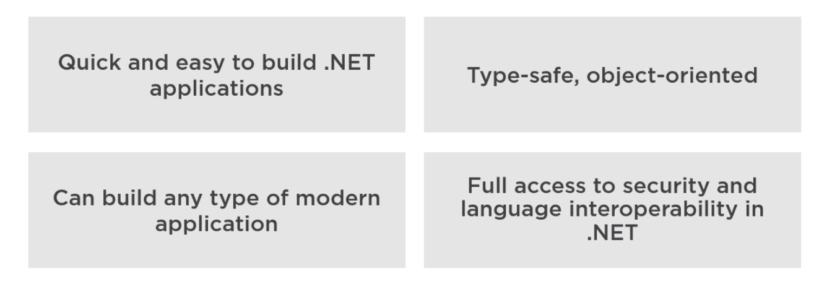
WHY VB.NET?

Slide 2
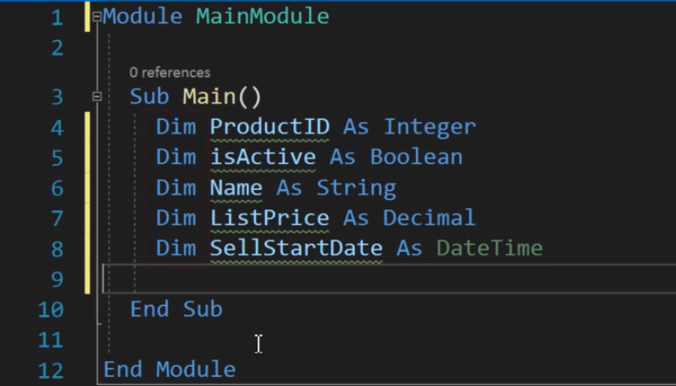
DECLARE MULTIPLE VARIABLES

Slide 3
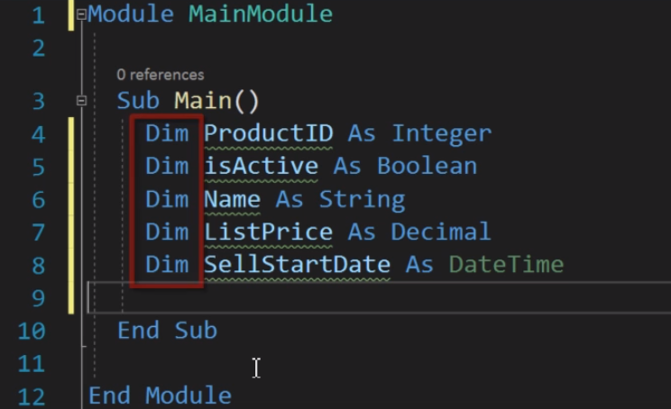
DECLARE MULTIPLE VARIABLES

Slide 4
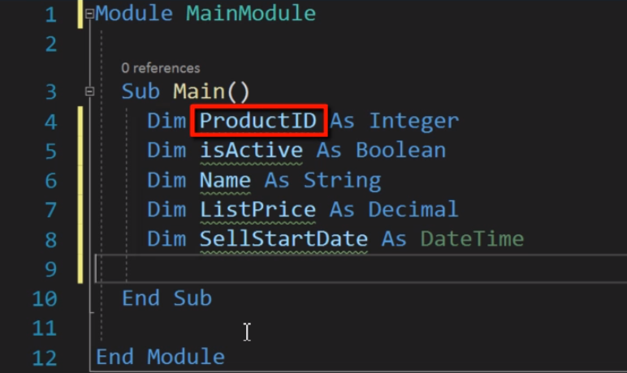
DECLARE MULTIPLE VARIABLES

Slide 5
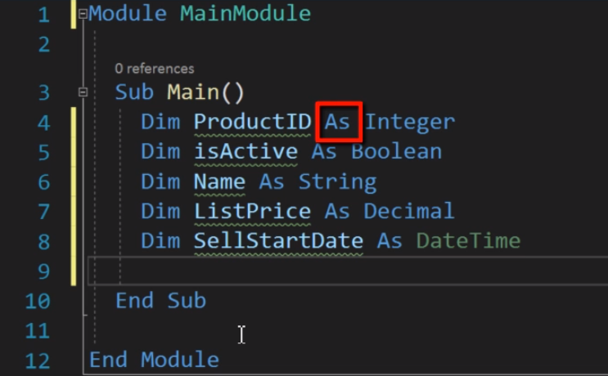
DECLARE MULTIPLE VARIABLES

Slide 6
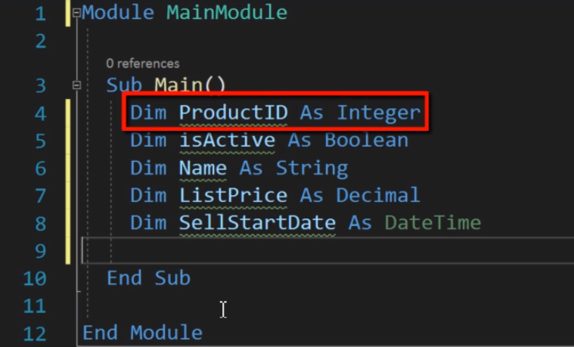
DECLARE MULTIPLE VARIABLES

Slide 7
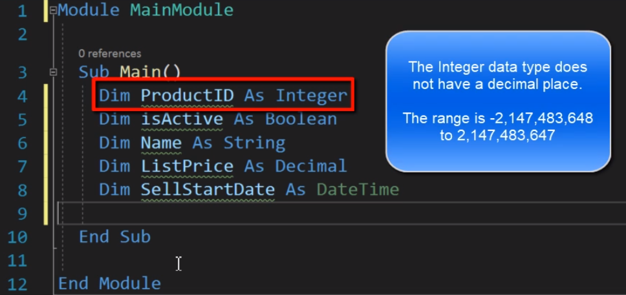
DECLARE MULTIPLE VARIABLES

Slide 8
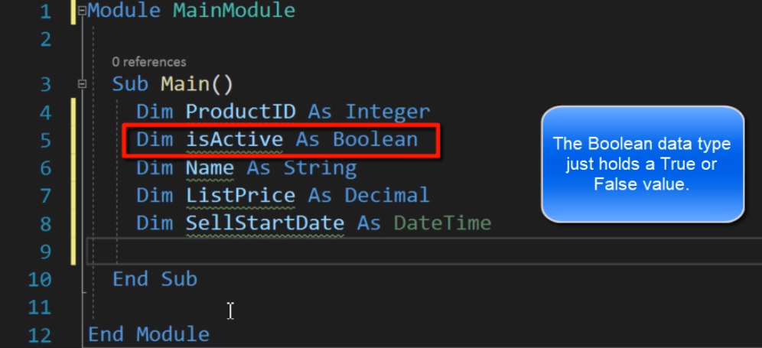
DECLARE MULTIPLE VARIABLES

Slide 9
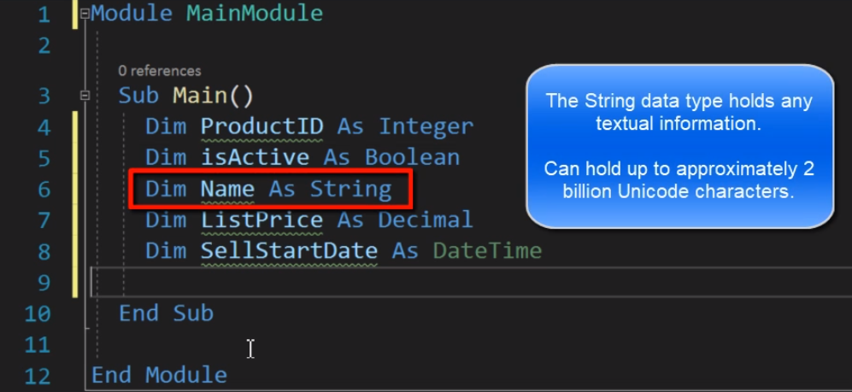
DECLARE MULTIPLE VARIABLES

Slide 10
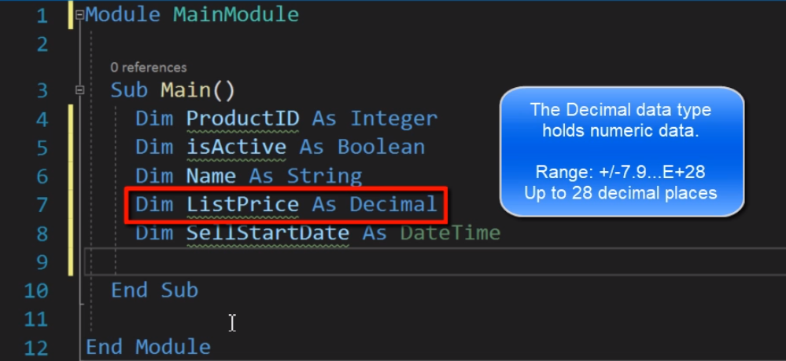
DECLARE MULTIPLE VARIABLES

Slide 11
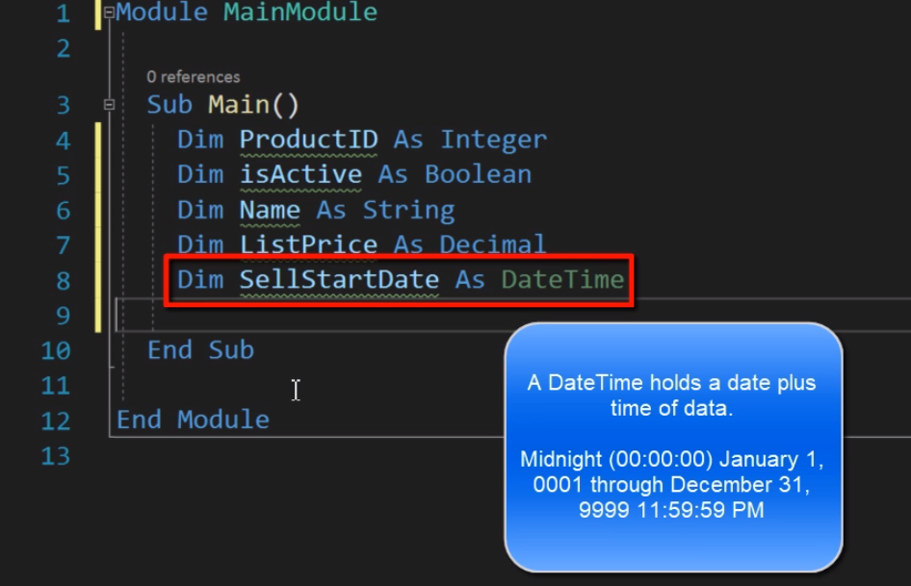
DECLARE MULTIPLE VARIABLES

Slide 12
DECLARATION AND INITIALIZATION OF VARIABLES
The Dim statement is used for declaring the variable using any data type.
It can also be used for declaring the variable of type enumeration, structure, class, or interface.

Slide 13
DECLARATION AND INITIALIZATION OF VARIABLES
Syntax for declaring variable:-
<Dim | Access Modifier> <Variable Name> As <Data Type>
Example:-
Dim A As Integer
Dim A As Double

Slide 14
DATA TYPES IN VISUAL BASIC
Short 16-bit -32,768 through 32,767
UShort 16-bit 0 through 65,535
Integer 32-bit -2,147,483,648 through 2,147,483,647
UInteger 32-bit 0 through 4,294,967,295
Long 64-bit -9,223,372,036,854,775,808 to 9,223,372,036,854,775,807
ULong 64-bit 0 through 18,446,744,073,709,551,615

Slide 15
DATA TYPES IN VISUAL BASIC
Single 32-bit floating point - 3.4028235E38 through 3.4028235E38
Double 64-bit floating point -1.79769313486231E308 through 1.79769313486231E308
Decimal 128-bit 0 through +/-79,228,162,514,264, 337,593,543,950,335 (+/-7.9...E+28)

Slide 16
DATA TYPES IN VISUAL BASIC
Byte 8-bit 0 through 255 (no negative numbers)
SByte 8-bit -128 through 127
Char 16-bit Any Unicode symbol in the range 0–65,535. Append “c” when initializing a Char.
String Usually 16-bits per character 0 to approximately 2 billion 16-bit Unicode characters

Slide 17
DATA TYPES IN VISUAL BASIC
Boolean 16-bit True or False. (During conversions, 0 is converted to False, other values to True.)
Date 64-bit January 1, 0001, through December 31, 9999
Object 32-bit Any type can be stored in a variable of type Object.

Slide 18
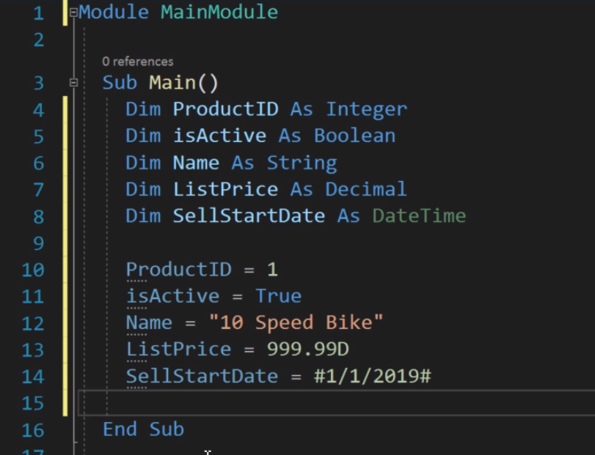
DECLARING AND ASSIGNING VALUES TO VARIABLES

Slide 19
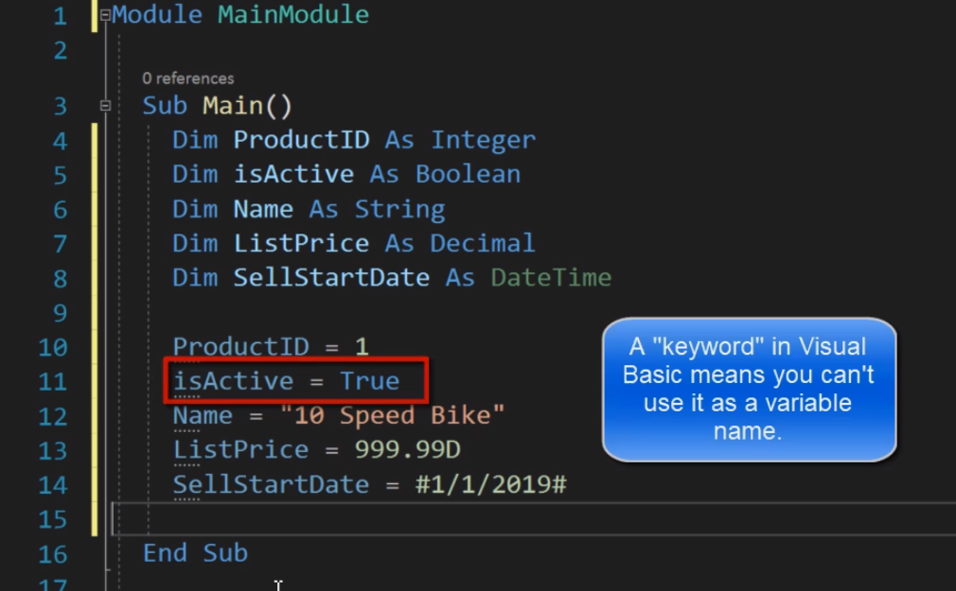
DECLARING AND ASSIGNING VALUES TO VARIABLES

Slide 20
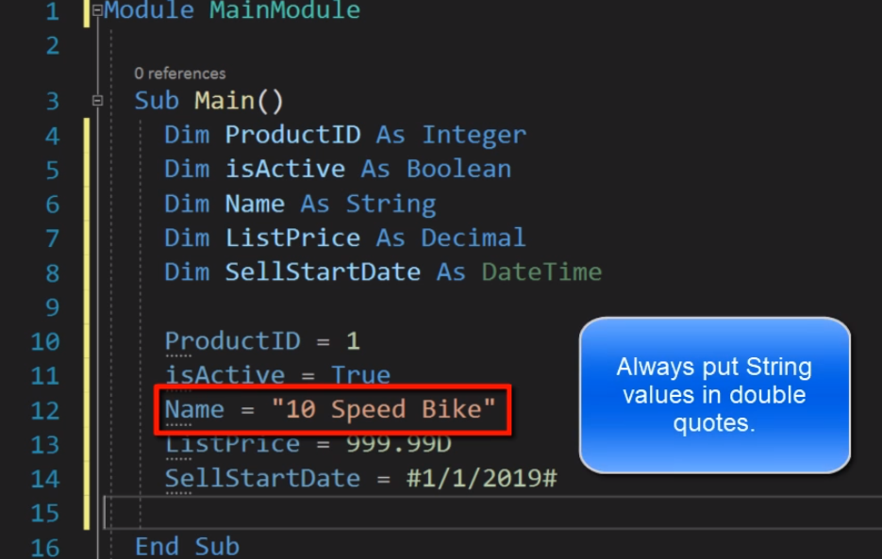
DECLARING AND ASSIGNING VALUES TO VARIABLES

